Slide 1
Patient management for the dental clinic final project
Sobhan asasi
Omid razzaghi
Seyed ali hashemi

Slide 2
titles
Sign in & Sign up
Patient Portal
Doctor Portal

Slide 3
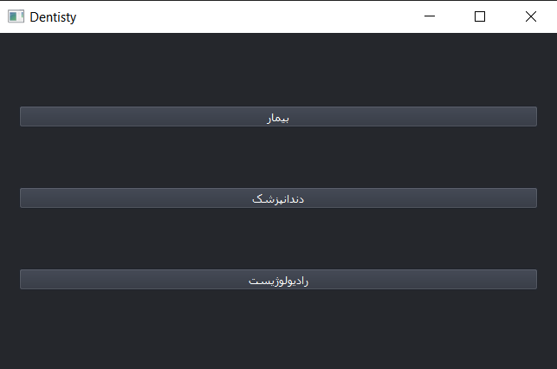
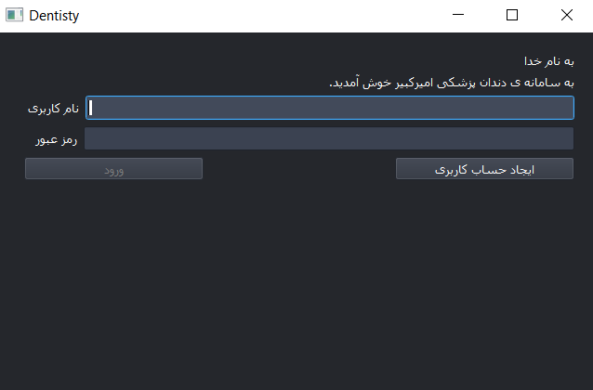
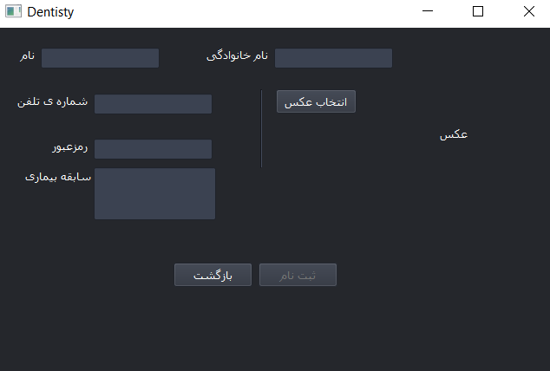
Sign in & Sign up
Select the role
Sign in
Sign up

Slide 4
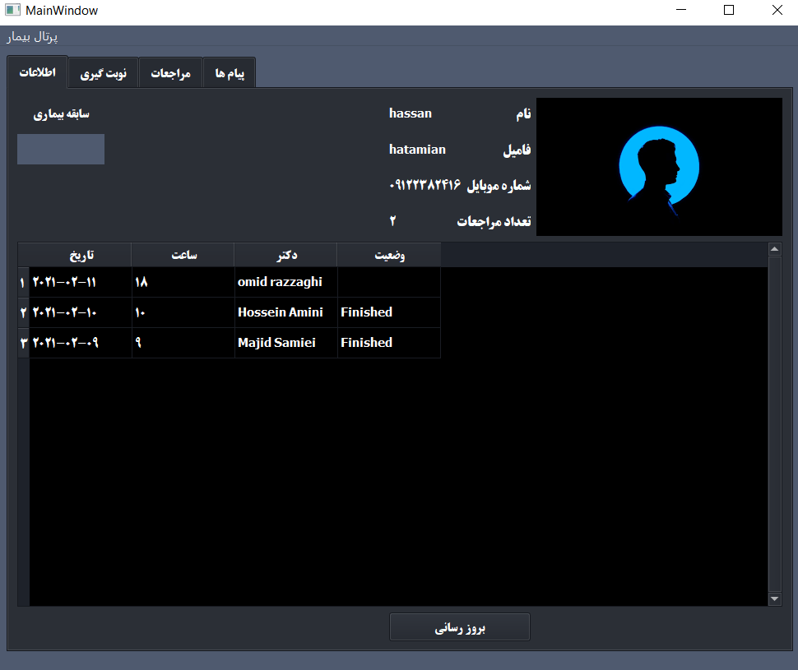
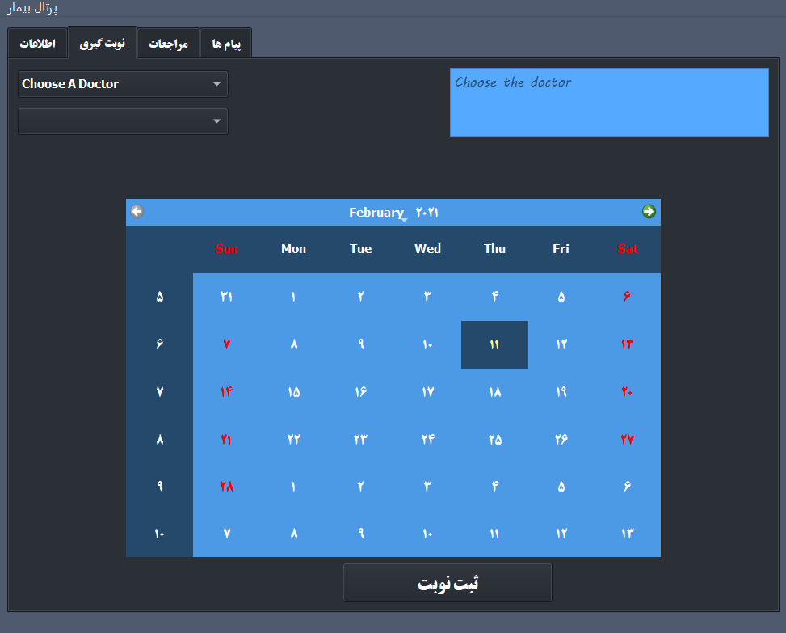
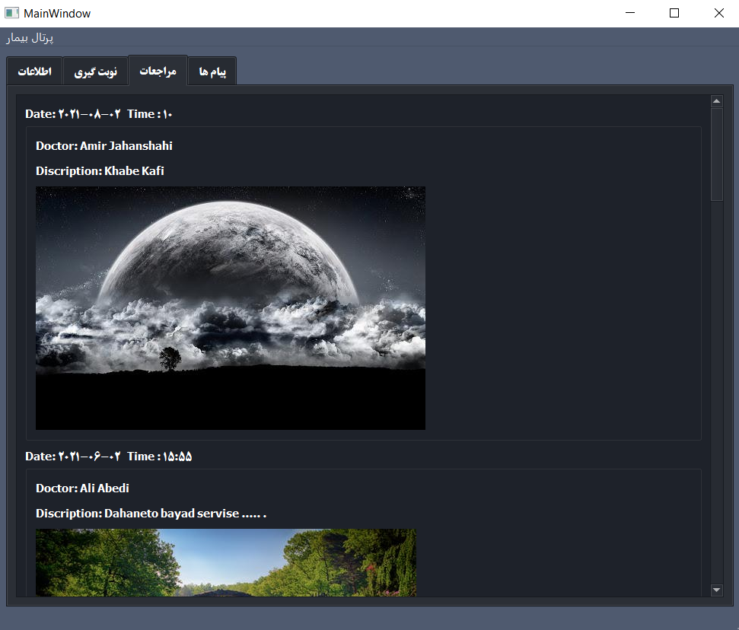
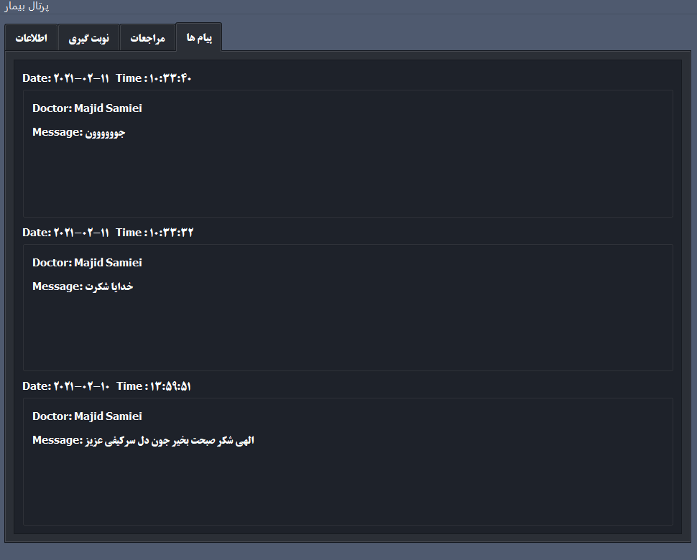
Patient Portal
Patient’s information
Scheduling
Resume
Massages

Slide 5
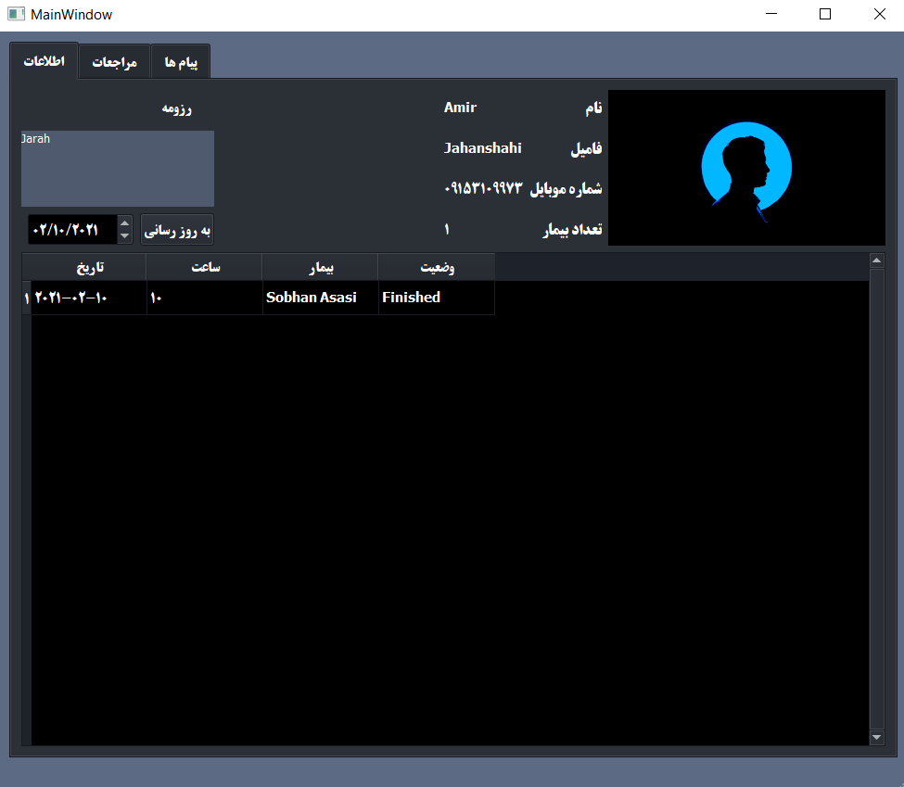
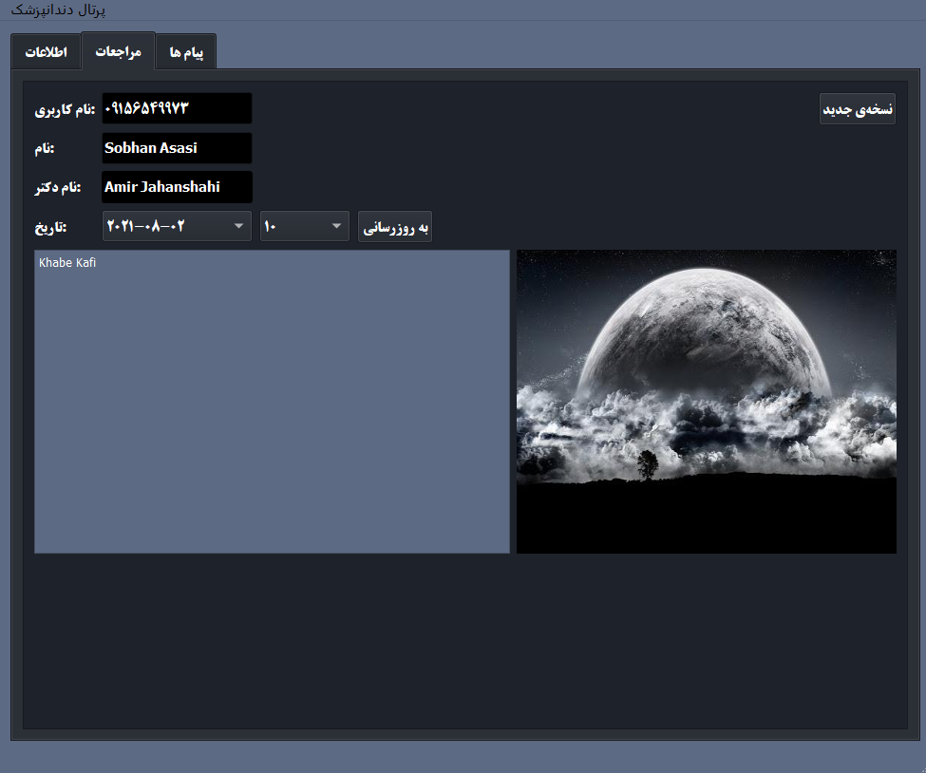
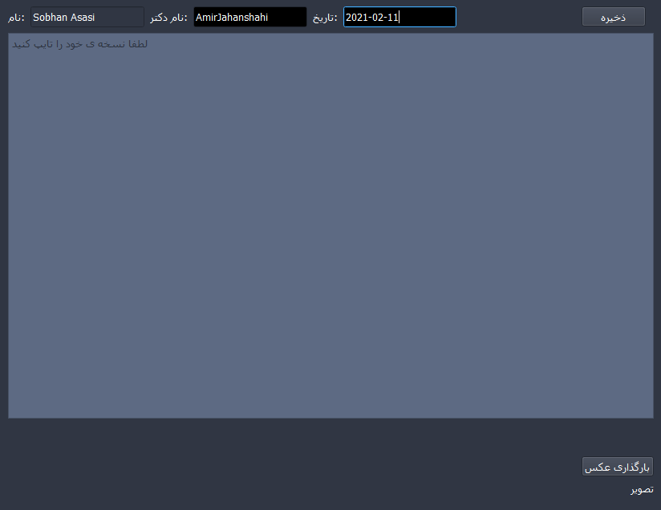
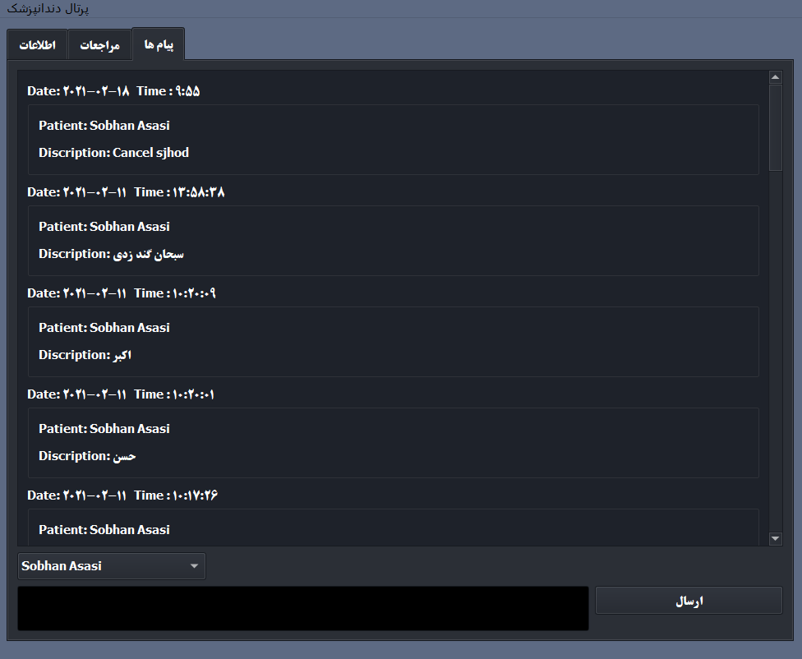
Doctor Portal
Doctor’s information
See previous resume
New prescription
Massages

Slide 6
THANK YOU FOR YOUR ATTENTION

